Slide 1
Voice Based E-mail System For Blind People
BATCH -12
Members-
Pradeep - 19z338
Sanjai - 19z344
Venkata Gowtham - 19z360
Chandraprakash - 20z461
Mukesh – 20z462

Slide 2
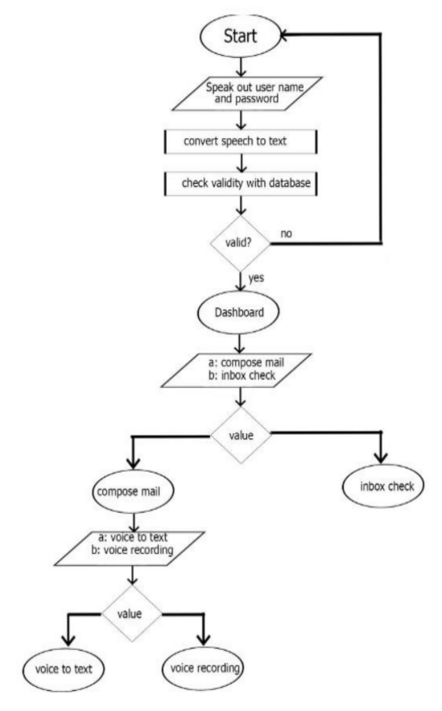
Block Diagram of the Project

Slide 3
Tools Used
Front end:
Visual studio
Microsoft Visual Studio is an integrated development environment (IDE) from Microsoft. It is used to develop computer programs, as well as websites, web apps, web services and mobile apps. Visual Studio uses Microsoft software development platforms such as Windows API, Windows Forms, Windows Presentation Foundation, Windows Store and Microsoft Silverlight.
Back end:
MS SQL
Microsoft SQL Server is a relational database management system developed by Microsoft. As a database server, it is a software product with the primary function of storing and retrieving data as requested by other software applications—which may run either on the same computer or on another computer across a network

Slide 4
Features
Implemented
Need to be Implemented
Voice recognition
Speech synthesis
User interface using voice command
G-mail or E-mail accessing
Mail sending facility
Mail receiving facility
External media access for attachment
Getting the input data in voice itself
Read out the received mail

Slide 5
Contribution & Challenges faced
Contribution
Challenges faced
sanjai (19z344) has taken care of receive page
pradeep (19z338) has taken care of send page
venkata gowtham (19z360) has taken care of log-in page
chandraprakash (20z461) has taken care of home page
mukesh (20z462) has designed the system and work with other four batch members.
The google e-mail security policy treat our system as third part software and not provide the permission to access the mail. In order the get the access we have turn on the less secure app option for the mail id which we have useded for sending the mail (from address).
The voice recognition and Speech synthesis are not able the process the special character and the numerical numbers.

Slide 6
THANK YOU

